Slide 1
The effect of turbulence upon supernova neutrinos
Jim Kneller
NC State University
NOW 2010

Slide 2
The signal from the next Galactic Supernova
The neutrinos we will detect from the next SN in our Galaxy will tell us much about the explosion and the neutrino.
The flavour content of the signal changes as it propagates from the proto-neutron star to our detectors here on Earth.
It evolves a number of times during the voyage:
within the first 1000 km due to neutrino self interactions,
due to the MSW effect, (L, H and maybe μτ resonances),
there may be flavour transformation due to turbulence,
de-coherence as the neutrino propagates to Earth,
and then Earth matter effects if the SN is 'shadowed'.

Slide 3
There has been rapid progress over the past few years in the understanding of how neutrinos propagate through a supernova.
In 2003 Schirato & Fuller showed that the explosion imprints itself upon the flavour composition through the MSW effect.
Schirato & Fuller, arXiv:astro-ph/0205390
In 2006 Duan et al. solved the multi-angle neutrino self-interaction problem in supernova.
Duan, Fuller, Carlson & Qian, PRL, 97, 241101 (2006)
Duan, Fuller, Carlson & Qian, PRD, 74, 105014 (2006)
For reviews see Duan & Kneller, JPhG, 36, 113201(2009) or
Duan, Fuller & Qian arXiv:1001.2799.
Turbulence is not yet satisfactorily included in calculations of the expected Supernova Neutrino Burst from a Galactic event.

Slide 4
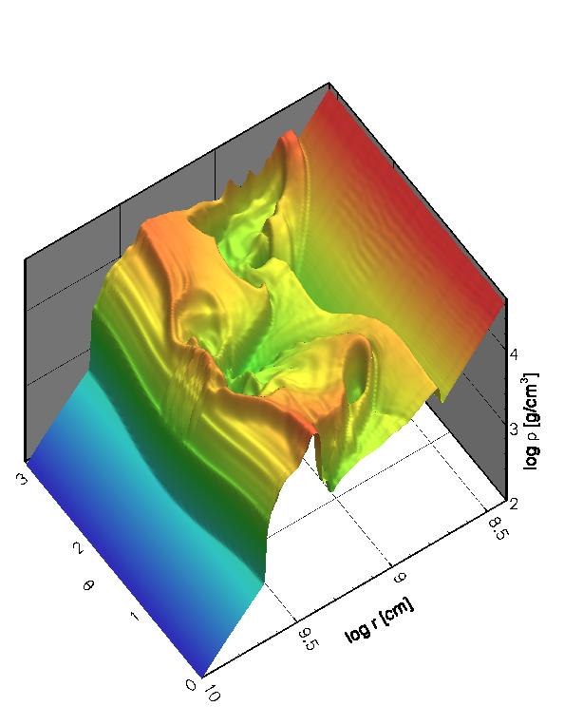
Turbulence
In multi-d hydro simulations we see turbulence generated by aspherical flows through distorted shocks, convection, etc.
Kneller, McLaughlin & Brockman,
PRD, 77, 045023 (2008)

Slide 5
Turbulence can lead to ‘depolarization’ so that the observed fluxes are equal mixtures of the fluxes emitted at the neutrinosphere.
Sawyer, PRD, 42 3908 (1990)
Loreti et al., PRD, 52, 6664 (1995)
Fogli et al., JCAP, 0606, 012 (2006)
Friedland & Gruzinov, arXiv:astro-ph/0607244
Depolarization would remove spectral features that indicate the hierarchy, θ₁₃ etc. and do not allow us to peer inside the SN.
A better understanding of turbulence effects and the implications for observables would be very desirable.

Slide 6
Revisiting Turbulence
Kneller & Volpe, 2010arXiv1006.0913K
We can take a supernovae profile from a 1D hydrodynamical supernova calculation and add turbulence to it i.e.
where F(r) is a Gaussian random field with rms amplitude C∗.
The turbulence is restricted to the region between the shocks.
Normally studies calculate the expectation values of the transition probabilities: i.e. ⟨P_{ij}⟩
Our approach was to calculate P_{ij} for instantiations of F.
After constructing an ensemble we can determine the average final state, the variance etc.
$$V_{e}=√2G_{F}n_{e}=V0 (1+F)$$

Slide 7
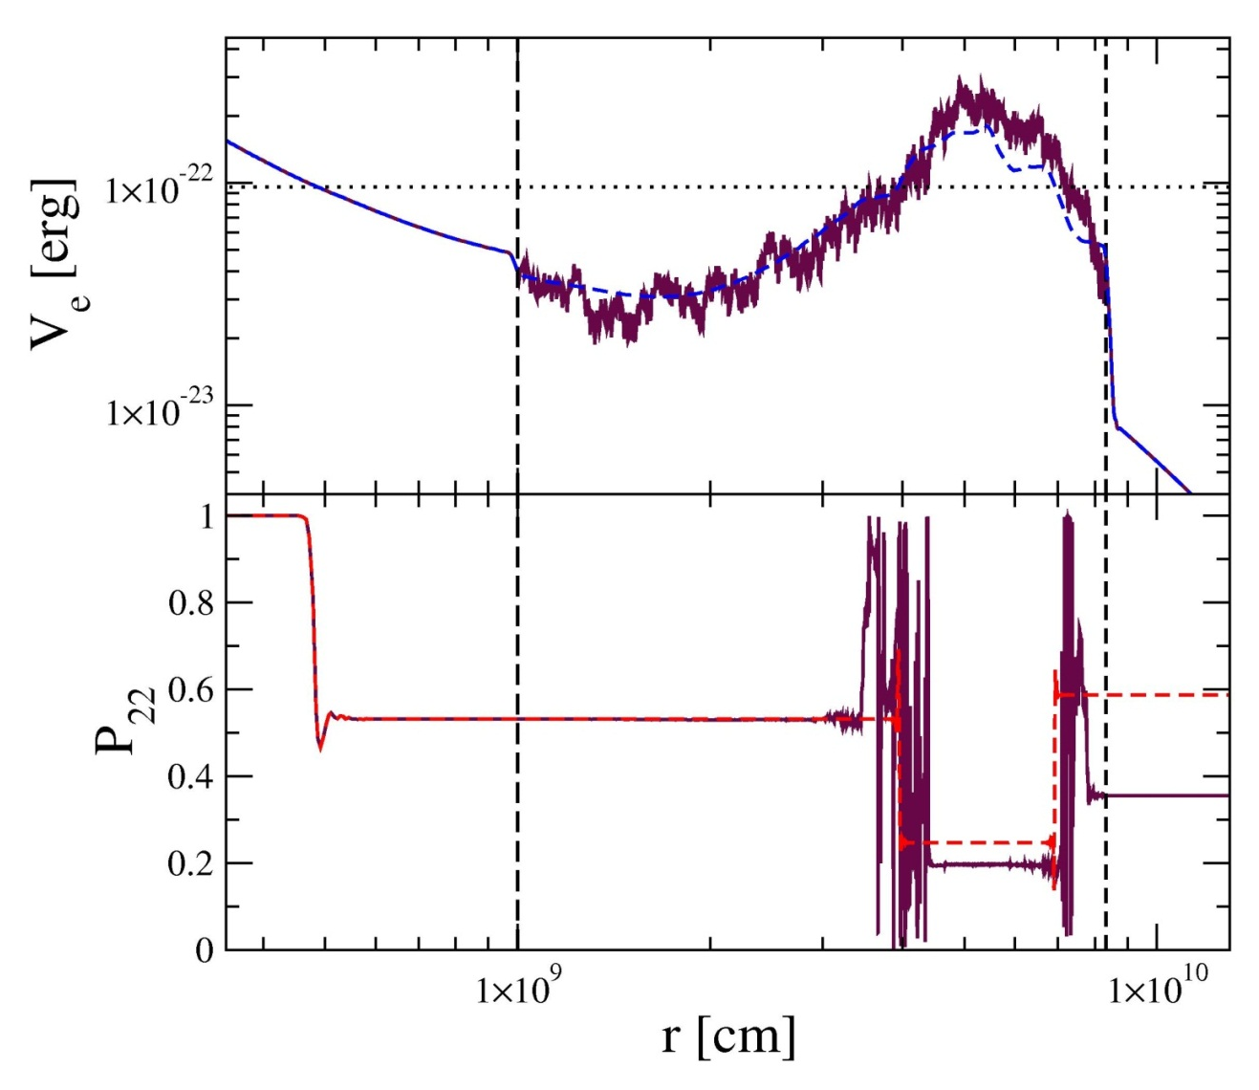
For example:
Kneller & Volpe, 2010arXiv1006.0913K
NH, E = 25 MeV, C∗ =0.32, sin² 2θ₁₃= 4 x 10⁻ ⁴
Turbulence introduces many more MSW resonances and also one observes off-resonance evolution.

Slide 8
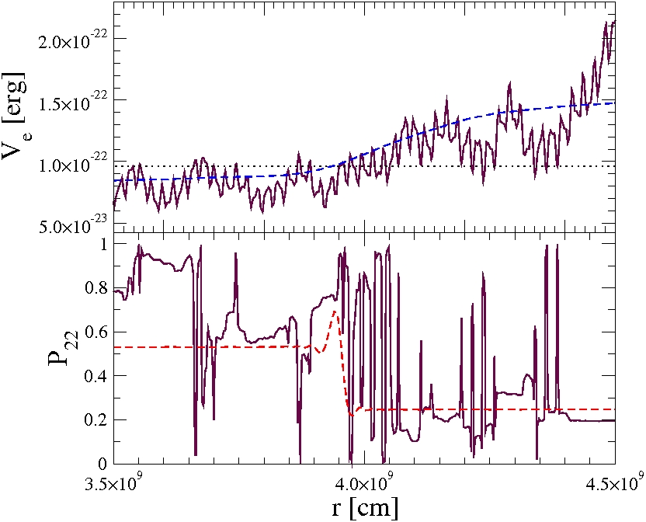
Turbulence introduces many more MSW resonances and also one observes off-resonance evolution.
NH, E = 25 MeV, C∗=0.32, sin² 2θ₁₃= 4 x 10⁻ ⁴

Slide 9
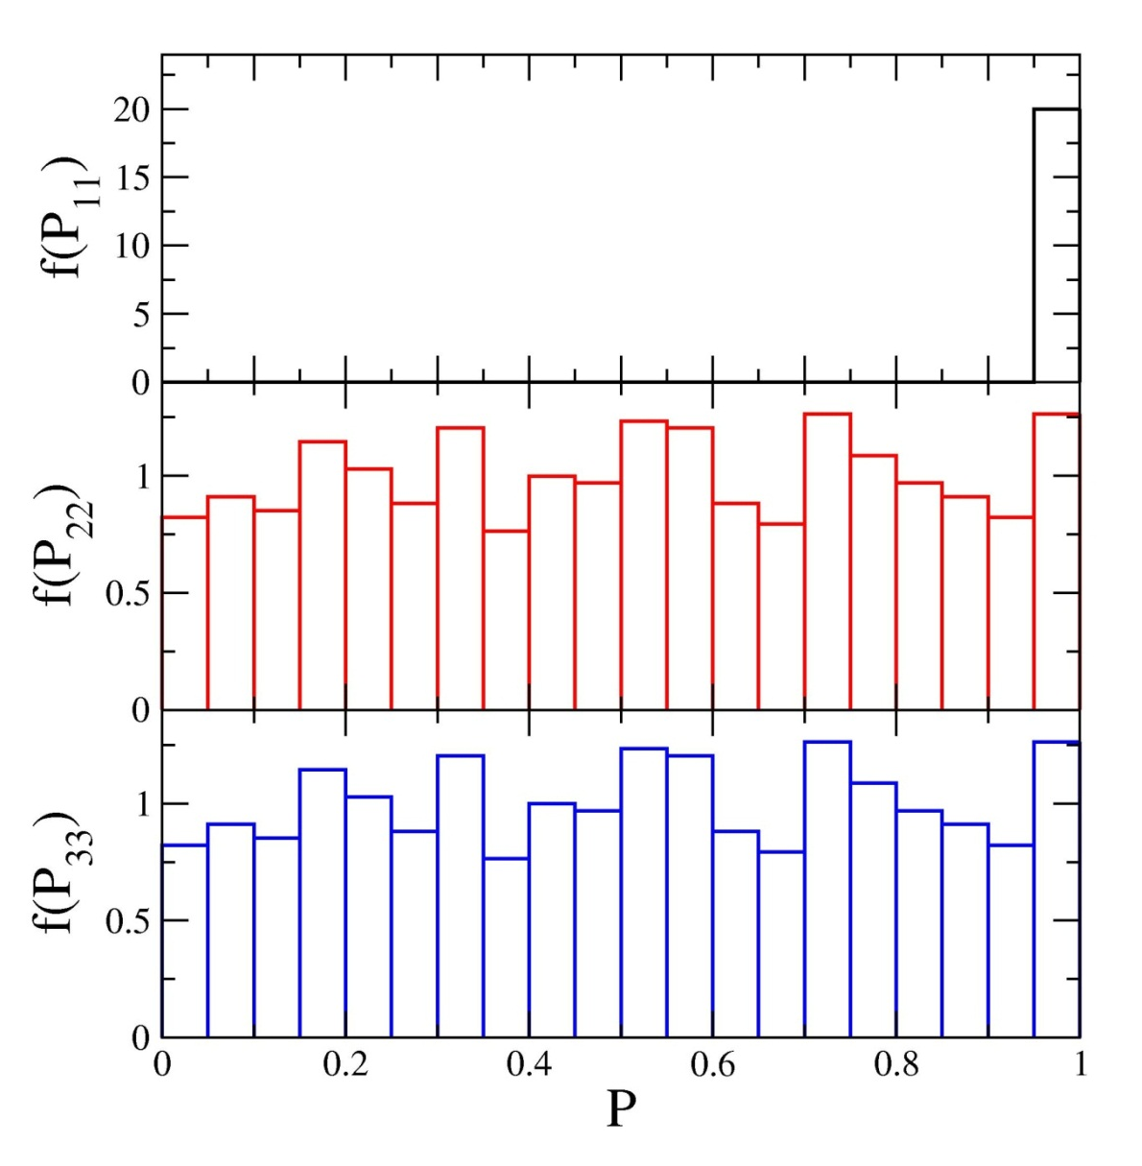
Quasi Two Flavour
Final state distribution from >1000 realizations of the turbulence.
NH, E = 25 MeV, C∗ =0.1, sin² 2θ₁₃= 4 x 10⁻ ⁴

Slide 10
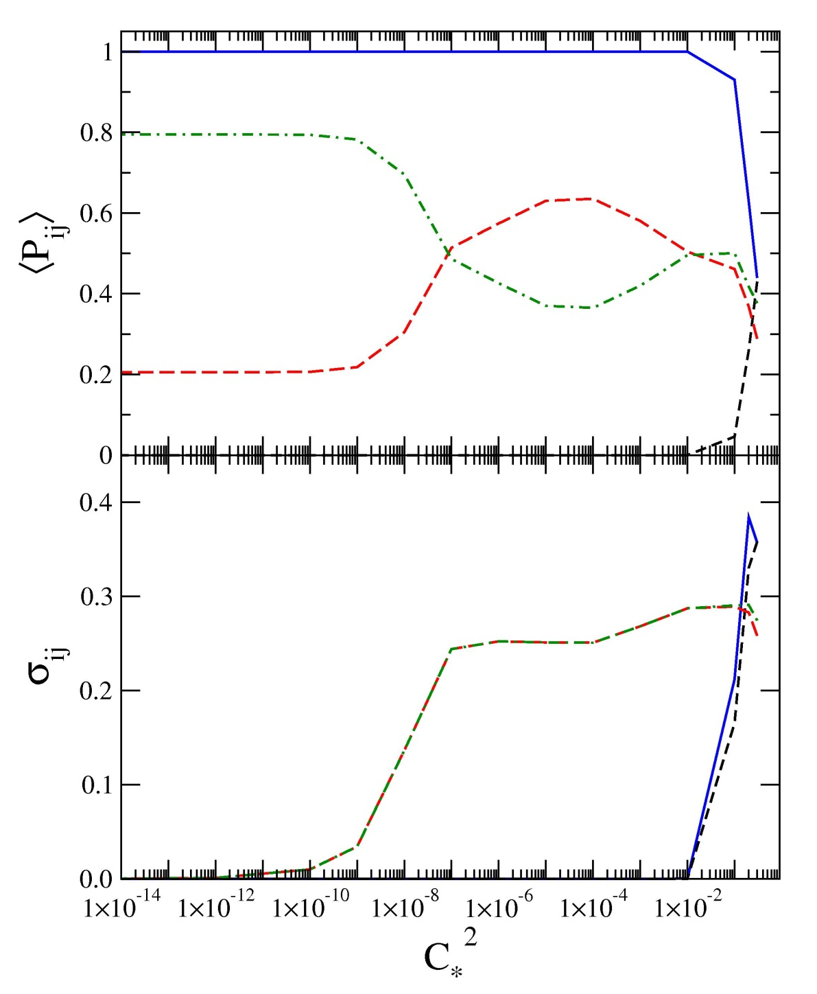
The figure can be divided into 4 regions:
C∗ < 10⁻⁵,
10⁻⁵ < C∗ < 10⁻²,
10⁻² < C∗ < 10⁻¹,
10⁻¹ < C∗.
Why are the neutrinos sensitive to fluctuations as small as 0.001%!
⟨P₁₁⟩
⟨P₂₃⟩
⟨P₂₂⟩
⟨P₁₂⟩
NH, E = 60 MeV, sin² 2θ₁₃= 4 x 10⁻ ⁴

Slide 11
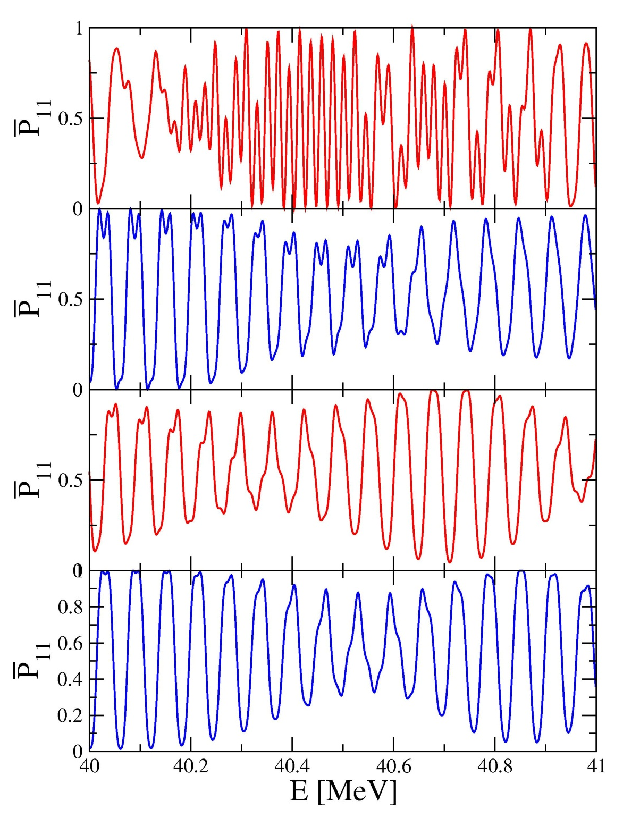
Even without turbulence the probabilities ‘oscillate’ due to interference effects between the extant resonances.
The interference depends upon the relative phase between resonances: i.e
P ∝ cos Φ
is typically large, O(10³).
Even small changes of the r’s and k’s of order O(10⁻³) can lead to π shifts of Φ.
C∗ = 10⁻¹
C∗ = 10⁻²
$$Φ=\int_{r_{1}}^{r_{2}}{dr}\left[k_{1}−k_{2}\right]$$
C∗ = 10⁻³
C∗ = 0
IH, sin² 2θ₁₃= 4 x 10⁻ ⁴

Slide 12
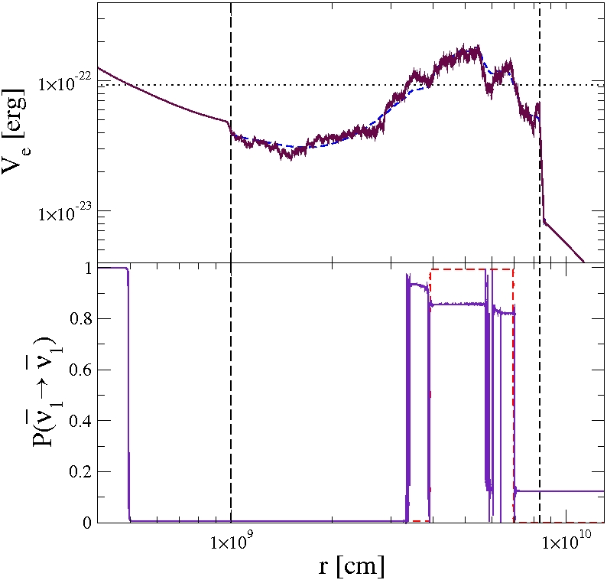
As θ₁₃ decreases every new resonance starts to become non-adiabatic and the off-resonance effect disappears.
IH, E = 25 MeV, C∗ =0.1, sin² 2θ₁₃= 4 x 10⁻ ⁶

Slide 13
Final state distribution of >1000 realizations of the turbulence.
Normal Hierarchy, E = 25 MeV, C∗ =0.1, sin² 2θ₁₃= 4 x 10⁻ ⁶

Slide 14
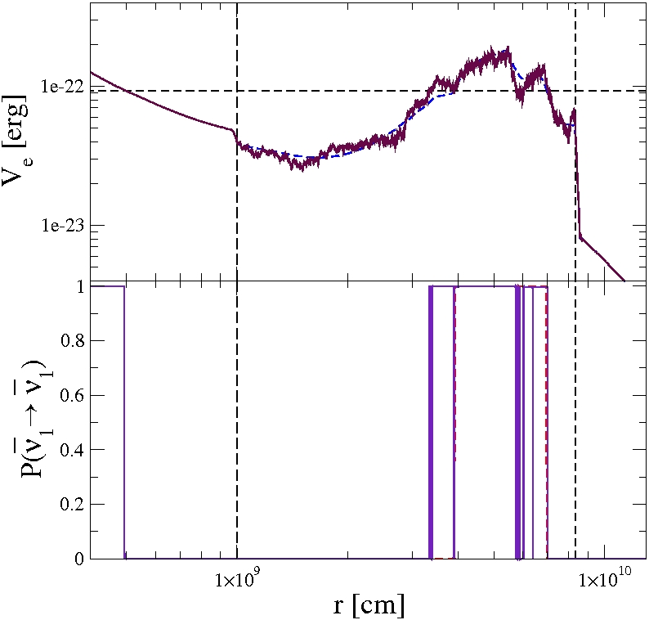
Inverse Hierarchy, E = 25 MeV, , C∗ =0.1, sin² 2θ₁₃= 4 x 10⁻ ⁸

Slide 15
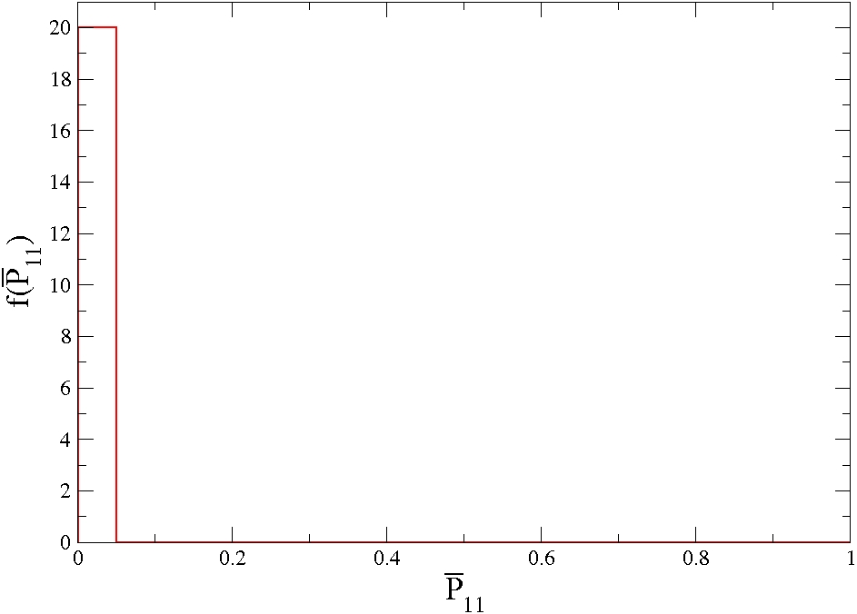
Inverse Hierarchy, E = 25 MeV, C∗ =0.1, sin² 2θ₁₃= 4 x 10⁻ ⁸

Slide 16
The evolution of ⟨P₂₂⟩ as a function of the mixing angle θ₁₃.
Dighe Smirnov
Normal Hierarchy, E = 25 MeV, C∗ =0.1

Slide 17
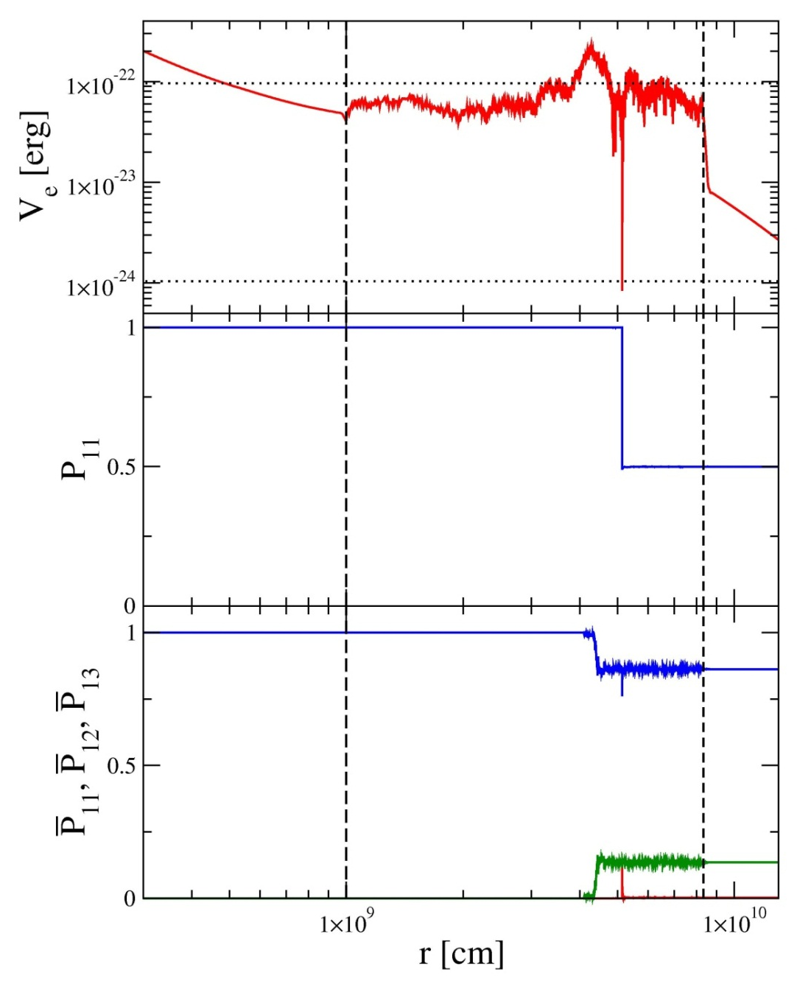
Three Flavour Turbulence
As the turbulence amplitude grows new effects emerge.
we break HL factorization,
evolution occurs in the non-resonant channels.
Also seen by Fogli et al., JCAP, 0606, 012 (2006)
NH, E=25 MeV, C∗ =0.32, θ₁₃= 9

Slide 18
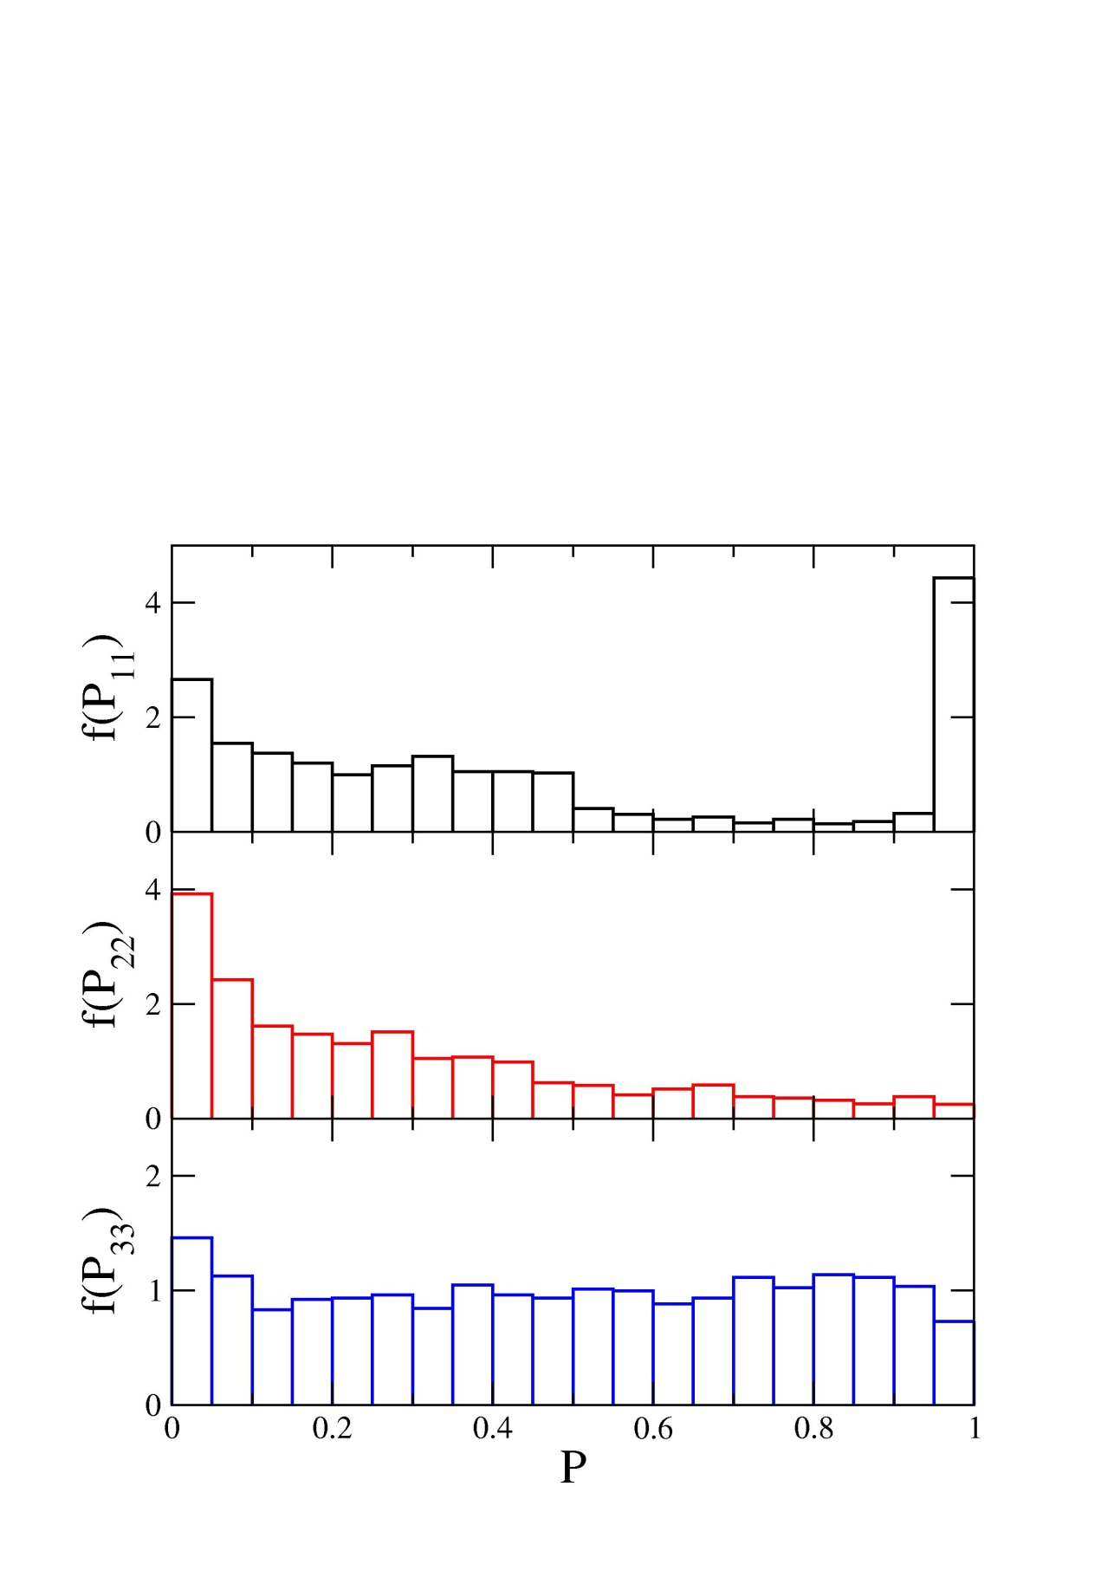
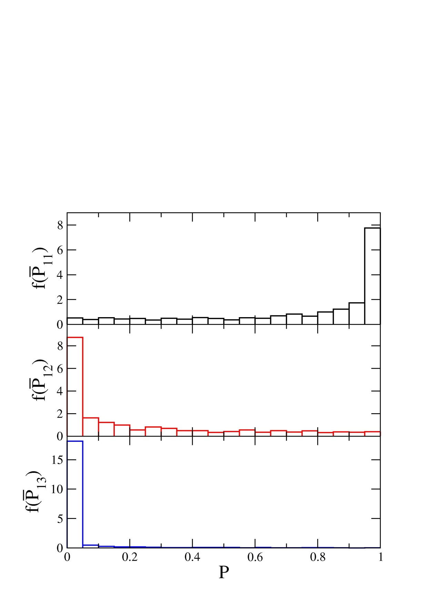
NH, E=60 MeV, C∗ =0.55, θ₁₃= 9
NH, E=25 MeV, C∗ =0.44, θ₁₃= 9
Kneller arXiv:1004.1288

Slide 19
⟨P₁₁⟩
⟨P₂₃⟩
⟨P₂₂⟩
⟨P₁₂⟩
For large C∗ we transition to 3-flavour depolarization where the distributions are traingular.
NH, E = 60 MeV, sin² 2θ₁₃= 4 x 10⁻ ⁴

Slide 20
Summary
Turbulence is not simple: what is affected very much depends upon the amplitude and the mixing parameters.
Turbulence may introduce new things to observe in places where nothing was visible without it:
it extends the range of sensitivity to θ₁₃ by roughly an order of magnitude,
and it can break HL factorization,
it leads to time-dependent signals in the non-resonant channels..

Slide 21
Normal Hierarchy, E=25 MeV, θ₁₃= 9

Slide 22
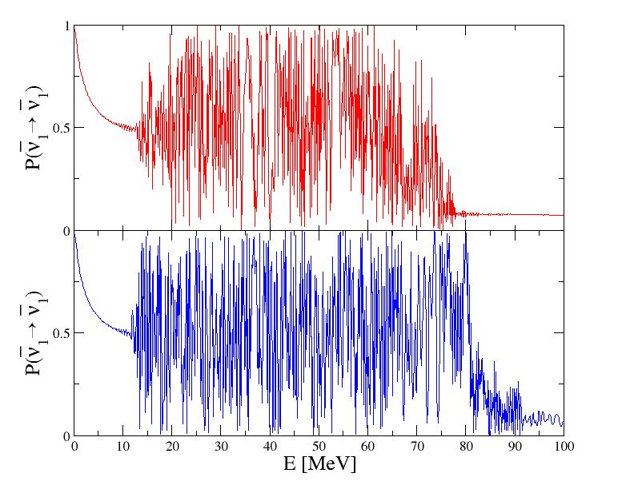
without
turbulence
with
turbulence
Inverse Hierarchy, sin² 2θ₁₃= 4 x 10⁻ ⁴

